Slide 2
Today
Objective:
Distinguish behavior change theories and models and predict effective ways to apply them in nutrition assessment, education, and counseling.
Today:
Presentations
Re-Cap ADIME practice
Draw pictures showing your personal theories of people’s wellness behavior…why do you think people do what they do?
Introduction to behavior change theories and models
Activity: determining appropriate behavior change theory/model for case studies
One minute essay

Slide 3
Presentations

Slide 4
Re-Cap from last week
Evaluate peers’ ADIME’s
Questions on the NCP tutorial?
Draft ADIME in discussion
Reflective Listening

Slide 5
Theories of Behavior Change
Module 5

Slide 6
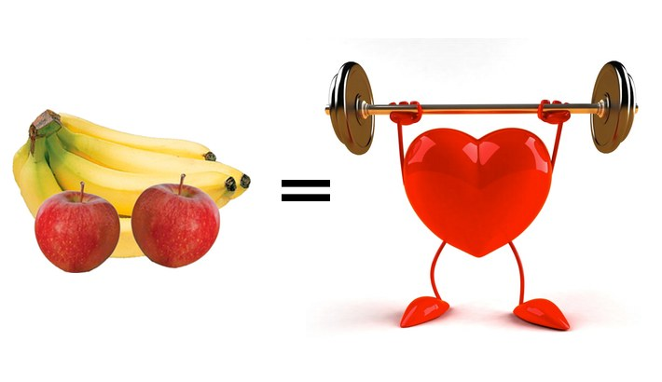
What Percent of people follow BASIC HEALTH GUIDELINES?
https://www.hhs.gov/fitness/resource-center/facts-and-statistics/index.html

Slide 7

Can changing Beliefs and knowledge affect behaviors?
U.S. adults with diet-related chronic diseases reported somewhat higher diet quality than nonpatients, especially among those patients with good nutrition knowledge and beliefs and use of food labels.
J. Nutr. 141: 1543–1551, 2011.

Slide 8
Big Picture Questions
What is a theory?
What is a model?
Why do we care about theories and models?
Notes:
Theory: a mental map devised, based on evidence to predict or explain health behavior.
Provides an explanation of why a behavior or behavior change occurs
Specifies the kinds of information that need to be gathered before designing an intervention
Provides guidance on how to design the various intervention components and educational strategies to reach people more effectively.
Provides guidance on exactly what to evaluate to measure the impact of the intervention.
Model: is a composite of constructs created from several compatible theories based on evidence

Slide 9
Big Picture Questions
Theory: a set of principles on which the practice of an activity is based.
Model: some abstract representation or approximation to an underlying theory
Notes:
Theory: a mental map devised, based on evidence to predict or explain health behavior.
Provides an explanation of why a behavior or behavior change occurs
Specifies the kinds of information that need to be gathered before designing an intervention
Provides guidance on how to design the various intervention components and educational strategies to reach people more effectively.
Provides guidance on exactly what to evaluate to measure the impact of the intervention.
Model: is a composite of constructs created from several compatible theories based on evidence

Slide 10
Big Picture Questions
Why do we care?
1) Explains why a behavior or behavior change occurs. What is the mechanism?
2) Expands our PES ideas and protects against narrow thinking and bias.
3) Specifies the kinds of information that need to be gathered to effectively design counseling & education.
3) Guides monitoring and evaluation.
Notes:
Theory: a mental map devised, based on evidence to predict or explain health behavior.
Provides an explanation of why a behavior or behavior change occurs
Specifies the kinds of information that needs to be gathered before designing an intervention
Provides guidance on how to design the various intervention components and educational strategies to reach people more effectively.
Provides guidance on exactly what to evaluate to measure the impact of the intervention.
Model: is a composite of constructs created from several compatible theories based on evidence

Slide 11
leading theories and models
Health beliefs model
Social cognitive theory
Transtheoretical Model
Cognitive behavioral theory
Social Ecological Model

Slide 12
Health Belief Model

Slide 13
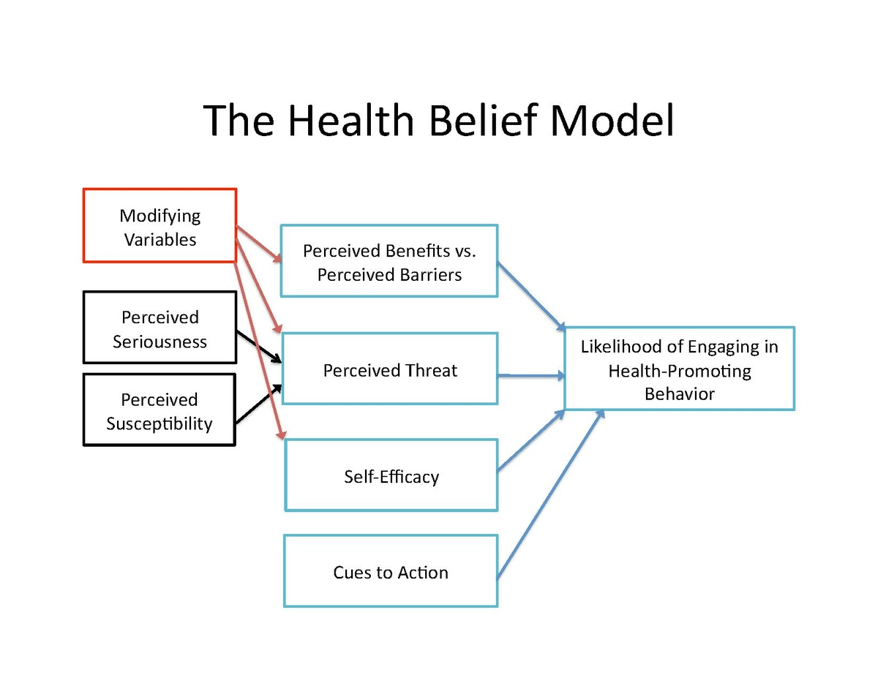

Slide 14
Health Belief Model
People’s readiness to take action or to make health behavior changes is influenced by their heath beliefs or convictions.
I am susceptible to the health risk/problem (perceived susceptibility)
The threat to my health is serious (perceived severity)
I’m convinced that the benefits of the recommended action outweigh the barriers or costs (perceived benefits and barriers)
I am confident I can carry out the action successfully (self efficacy)
Cues to action are present to remind me to take action (Cues to action)

Slide 15
Add Ran by NYC

Slide 16
Example Case Study HBM:

Slide 17
Example Case Study HBM:
What questions would you ask to explore whether health beliefs-type factors are the main barriers to healthier behaviors?
What types of answers suggest health beliefs are barriers?

Slide 18
The Social Cognitive Theory

Slide 19
The Social Learning Theory
Holds that portions of an individual's knowledge acquisition can be directly related to observing others within the context of social interactions, experiences, and outside media influences.
People do not learn new behaviors solely by trying them and either succeeding or failing, but also through the replication of the actions of others. Others could be in media, family, community, etc.
Treatment emphasizes increasing client’s confidence for productively responding to or modifying her or his social and physical environment.
We choose actions that maximizes the anticipated positive outcomes and minimizes the anticipated negative outcomes.

Slide 20
Example Case Study Social cognitive theory:

Slide 21
Example Case Study SCT:
What questions would you ask to explore whether social cognitive factors are the main barriers to healthier behaviors?
What types of answers suggest social cognitive barriers?

Slide 22
The Transtheoretical Model
(Stages of Change)

Slide 23
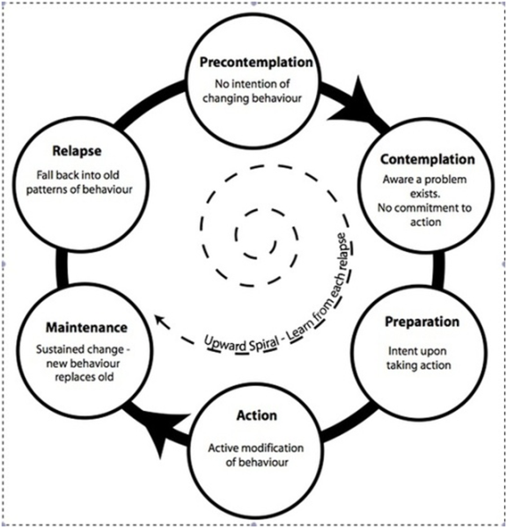
transtheoretical Model

Slide 24
The Transtheoretical Model
(Stages of Change)
Behavior change occurs in stages:
  pre-contemplation
  contemplation
  preparation
  action
  maintenance
  relapse.
Treatment focuses on using the best strategy for the current stage of change.
Changes in stage are not always linear

Slide 25
Give an example of a client in each stage of the TTM
Pre-contemplation: not aware or not interested
Contemplation: considering making a change within 6 months
Preparation: intend to make a change within 1 month
Action: have started making the change within the previous 6 months
Maintenance: performed the new behavior for at least 6 months
Relapse: temporarily suspend behaviors
Termination: quit trying or will always engage in the behavior

Slide 26
Example of Staged Intervention: What would we do?
Worksite wellness program

Slide 27
Example of TTM Intervention
Worksite wellness program to increase fruit and vegetable intake
  Promotional activities to raise awareness
  Action and skills training
  Social support and maintenance of behavior
  Environmental supports

Slide 28
Cognitive Behavior Therapy
Behavior is related to habitual thinking patterns. Through thinking and perceiving, people often magnify emotional responses to adverse experiences and behave inappropriately in response to the emotion.
Treatment focuses on examining and revising the relationships between thoughts, feelings and behaviors.

Slide 29
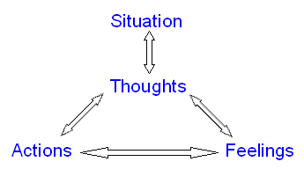
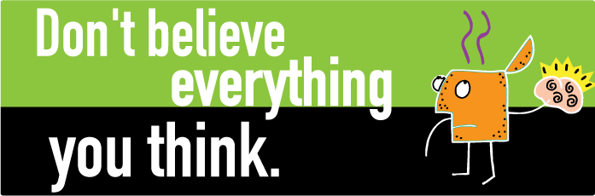
Cognitive Behavior Therapy

Slide 30
example case study CBT-type problem

Slide 31
Cognitive Behavior Theory
What questions would you ask to explore whether the client has habitual thinking and acting patterns that are the main barriers to healthier behaviors?
What types of answers suggest habitual thinking patterns are significant barriers?

Slide 32
Practice Theories-Models

Slide 33
The Social Ecological Model
(the theory of everything)
Notes:
Addresses multiple influences on behavior change.
Cooking with kids example:
Individual-level intervention: tasting lessons, cooking lessons, affordable foods from diverse cultures, foods in history, food journal activities, and take home recipes
Family-level activities: volunteer participation, family get togethers at school – cooking and eating together, events and incentives
Institutional or environmental level: improvements in meals offered at school through collaborations with others, foods cooked in classrooms adapted and served in school meals.

Slide 34
Example: Cooking with Kids
Individual-level intervention: tasting lessons, cooking lessons, affordable foods from diverse cultures, foods in history, food journal activities, and take home recipes
Family-level activities: volunteer participation, family get togethers at school – cooking and eating together, events and incentives
Institutional or environmental level: improvements in meals offered at school through collaborations with others, foods cooked in classrooms adapted and served in school meals.
http://cookingwithkids.org/

Slide 35
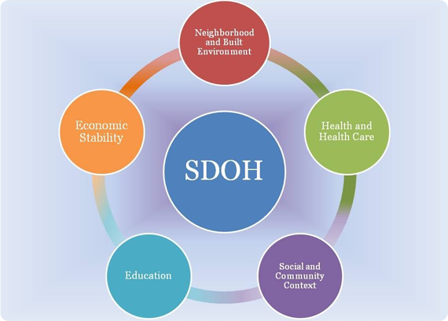
The Social ‘Determinants' of Health

Slide 36
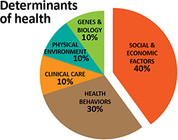
Estimated Pie Chart of
All the ‘Determinants' of Health

Slide 37
One Minute Essay
What questions do you have about this week’s topic of Behavior Change Theories/Models?
How do you feel the semester is going so far? We’re 1/3 of the way through the semester!

